Slide 1
Spelling – a parent workshop
Mount Hawke Academy
Jo Davidson – Cornwall Dyslexia Service

Slide 2
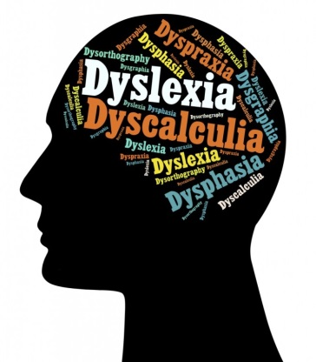
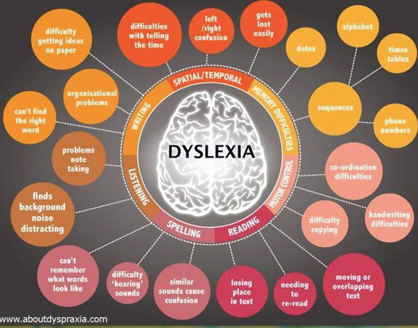
Dyslexia – what is it?
Memory difficulties
Organisational difficulties
Reading/Writing difficulties
Visual processing difficulties
Auditory processing difficulties
Sensory distraction/overload

Slide 3

Homework: Top tips and how you can help
Establish a Routine
Develop a daily spelling practice routine. Try and encourage your child to complete their spellings in the same place each time.
Practice is required for children to develop and master their spelling skills. Try 5 minutes a day!
Spell along with your child when they get
frustrated. This helps them to understand
and enjoy what they are doing.

Slide 4

Homework: Top tips and how you can help
Getting started
Divide homework tasks into manageable chunks.
Little and often is the key!
Give breaks between tasks. Encourage your child to produce quality work rather than rushing tasks.
Read instructions aloud, if necessary, complete the first spelling example or two with them.
Encourage them to play with their spellings e.g. underline or highlight key words in colour, draw pictures etc to aid their memory.

Slide 5

Homework: Top tips and how you can help
Checking and monitoring work
Help your child to learn to check their own work so they can go over their own work more independently as they get older.
Teach your child to use the computer for work as they get older. Show them how to use a spell checker and encourage them to learn touch typing skills.
If they are slow to complete work, see how much work they can do in e.g. two minutes. Using a stopwatch can make it more fun and visual.
Give your child lots of praise as they complete homework tasks.

Slide 6


Homework: Top tips and how you can help
Organisation
Encourage your child to keep their spelling sheets/lists/books together in folders so they don’t get lost or damaged. Colour coding of subjects can greatly help your child’s organisation.
Chat with your child’s teacher regularly to check that they are handing in their completed homework at school.
It is helpful to make sure that everything needed for the next school day is packed up the night before and placed by the front door.

Slide 7
Understanding and supporting spelling
What does spelling require?
Spelling requires recall
Reading requires recognition
Recall is harder than recognition
Let’s have a go at a spelling activity

Slide 8
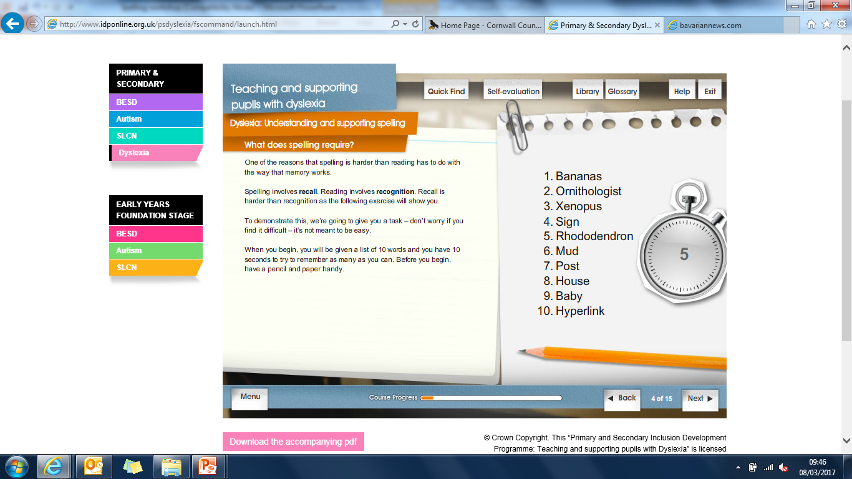

Slide 9
How many did you get?
Write down all of the words that you can remember…this is recall.
Now we will try recognition. Look at the following slide and write down the words that appeared in the spelling list.

Slide 10


Slide 11
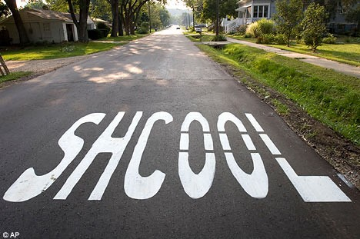
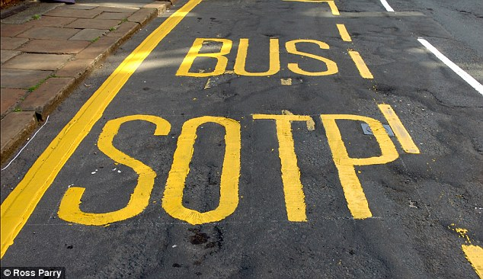
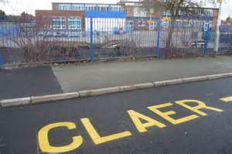
The wonderful world of spelling!
Please write down the words, which in your opinion, contain a spelling mistake. The highest number ticked so far is 4 - but that is still not right!
withhold | parallel | assassin | diarrhoea
liaison | hypocrisy | gauge | restaurateur
moccasin | supersede | unnecessary | vermillion
besiege | pavilion | cemetery | rhododendron

Slide 12
English is hard
green
bead
thief
paediatrician

Slide 13

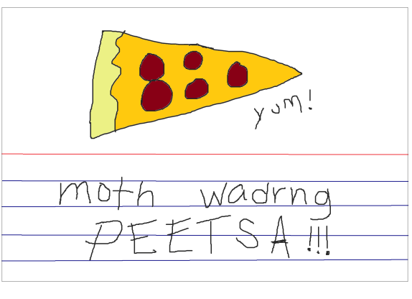
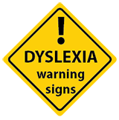
Typical spelling errors
Your child may make ‘typical’ spelling mistakes
Words and letters can become jumbled in your child’s mind.
Spelling words as they sound, e.g. wont instead of want
Mixing up the sequence of letters, e.g. hlep instead of help
Reversing the sequence of letters, e.g. was instead of saw
Using a ‘t’ instead of ‘ed’, e.g. lookt instead of looked
Missing out a letter, e.g. wich instead of which
Adding an extra letter, e.g. whent instead of went
Notes:
These are typical spelling mistakes and almost every child makes mistakes of this nature.
What does spelling require?
Spelling requires recall
Reading requires recognition
Recall is harder than recognition
One of the reasons that spelling is harder than reading has to do with the way that the memory works. Spelling involves recall. Reading involves recognition. Recall is harder than recognition
Traditionally most children with dyslexia have poor working memory.

Slide 14
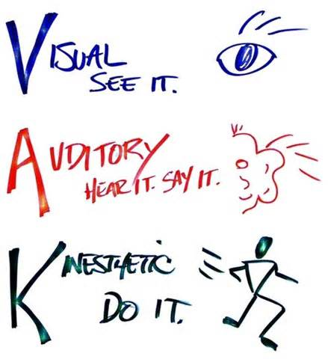
Introducing multisensory ways to learn spellings
Multisensory spelling is visual (what we see), auditory (what we hear) and kinaesthetic (what we feel) all at the same time. This helps memory and learning.
Using multisensory techniques allows links to made between the visual, auditory and kinaesthetic pathways in learning to read and spell.
I see what you mean.
Most children (and adults!) have a preferred way to learn.
That sounds good to me.
Try it!
Discuss –
what sort of
learner are
you?
That feels right to me.

Slide 15
Multisensory Spelling Techniques
The adult - writes the word and says it
The child - looks at it and repeats it then:
Spells it out using letter names
Repeats the word again
Copies the word, naming the letters as they are written.
Reads the word
Covers the word and writes it again, naming the letters as they write.
Checks their attempt with the original.
Try it!
Pair up. One is
the adult, one is
the child. I will give you a word to spell.

Slide 16
Practical ideas for learning spellings at home
Spelling Dice!
Roll the die – if it lands on:
1. Think of a picture to represent the word.
2. Draw a mnemonic to help spell the word.
3. Spell out word using letter names.
4. Write word in air with finger.
5. Write word down on paper.
6. Close your eyes and imagine spelling out the word in your head.

Slide 17
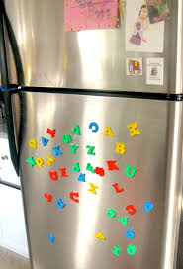
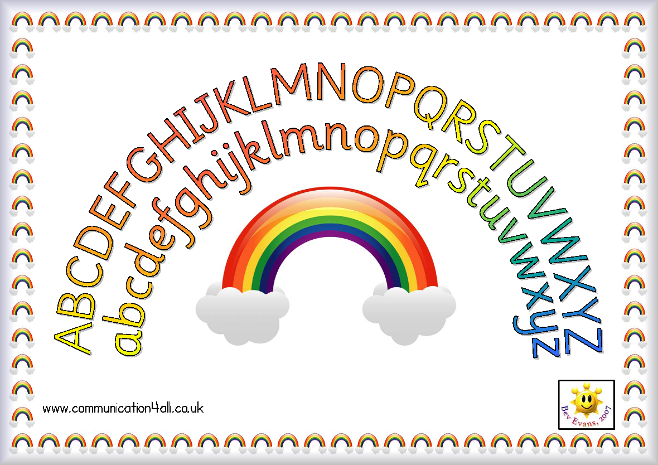
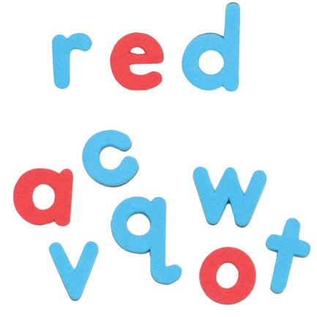
Practical ideas for learning spellings at home
Display illustrated key word lists around the home (on walls, doors, fridges etc). Magnetic letters can also be used. Make sure the letters are lower case. Easily available on Amazon. When spelling words with magnetic letters, try using a different colour for the vowels.
Download/print out an alphabet arc.
Wooden/
plastic letters on top
Child pulls the letters down to make the word

Slide 18
Practical ideas for learning spellings at home
Write a word broken down into syllables on a post-it, jumble it up and ask your child to put it back together.
for
get
ful
Try it!
Pair up. Split a
word up and write
its syllables
on separate
post-its.
September
department
carpenter
propeller
telephone
Saturday

Slide 19
Practical ideas for learning spellings at home
Highlighting common letter patterns in words. i.e retreat and defeat.
Use a highlighter to visually show the difference. If using magnetic letters, try using a different colour for the letter patterns.
street | good | pass
green | food | compass
sleep | blood | bypass
see | flood | passenger
three | stool | trespass
tree | wood | compassion
Try it!
Copy down a
word family and
highlight the common letter patterns.

Slide 20
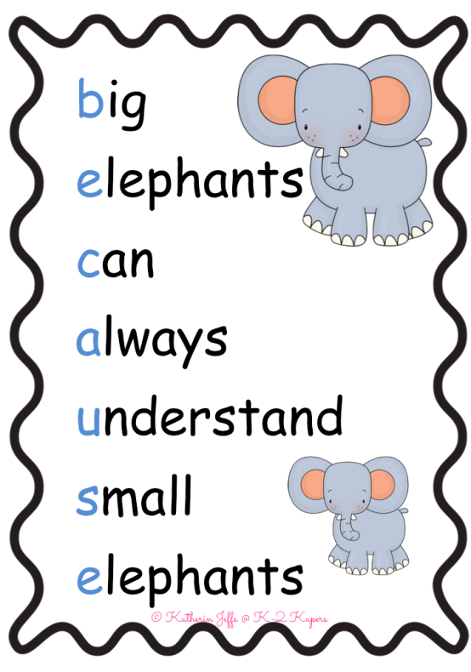
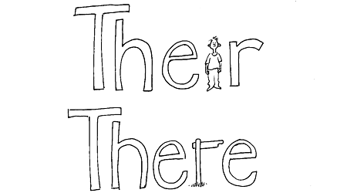
Practical ideas for learning spellings at home
Create mnemonics for ‘tricky’ words
A mnemonic is a memory aid and can help children to remember the spelling of tricky words.
Mnemonics can be visual or written.
Only practise one spelling until it is secure.
Written
Visual

Slide 21
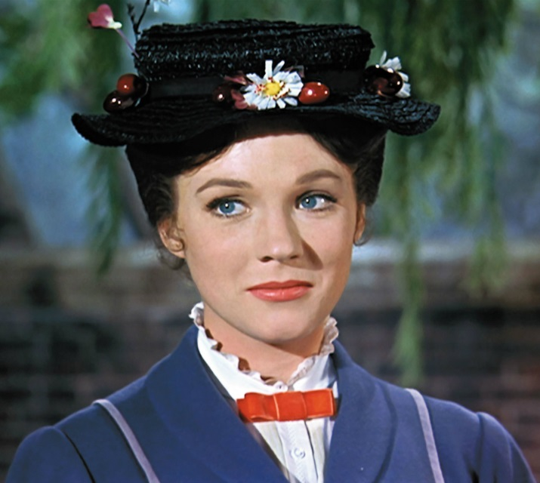
Helping children to recognise syllables
Play ‘how many syllables?’
Draw a line for each syllable.
Spell each syllable in turn remembering the basic rules of spelling.
????????????
Try it!
Spell the long word that Mary Poppins sang about!
Break it down into syllables, how many are there?

Slide 22

Supercalifragilisticexpialidocious
14 syllables
su/per/cal/i/frag/i/lis/tic/ex /pi/al/i/do/cious

Slide 23
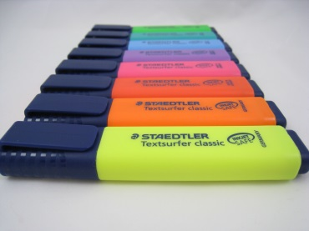
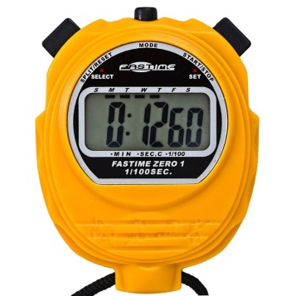
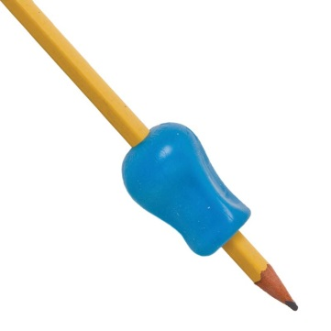

Building confidence at home – creating independence
Whiteboards/pens
Magnetic/wooden letters
Word lists/mats
Pens/pencils/pencil grips
Blank mnemonic cards (playing cards)
Clear acetates and pens
Post it notes
Highlighters
Stop watch
Overlays/reading rulers
Alphabet lines/key vocabulary books

Slide 24
Resources to help at home with spellings:
https://www.nessy.com/uk/ - computer software. Comes well-recommended by parents and you can download it for free for a trial period.
http://www.bbc.co.uk/bitesize/ks2/english/spelling_grammar/ - KS2 focus
http://www.topmarks.co.uk/english-games/7-11-years/spelling-and-grammar - games that can be played online
http://suzieshomeeducationideas.blogspot.co.uk/2013/09/25-multi-sensory-activities-for.html - more multisensory ways to learn spellings
http://www.communication4all.co.uk/http/ClassroomBasics.htm - downloadable alphabet arc (near the bottom of the page)
http://www.bbc.co.uk/skillswise/game/en01soun-game-syllables-factory - syllables recognition game
http://resources.woodlands-junior.kent.sch.uk/interactive/literacy.html - great school website with lots of spelling games (and has other topic areas on there too)
200 Tricky Spellings in Cartoons: Visual Mnemonics for Everyone by Lidia Stanton (available on Amazon for £5.99
10 Minutes A Day Spelling KS1 (English Made Easy Ks1 and KS2) by Carol Voderman (available on Amazon for around £5 each)

